Slide 1
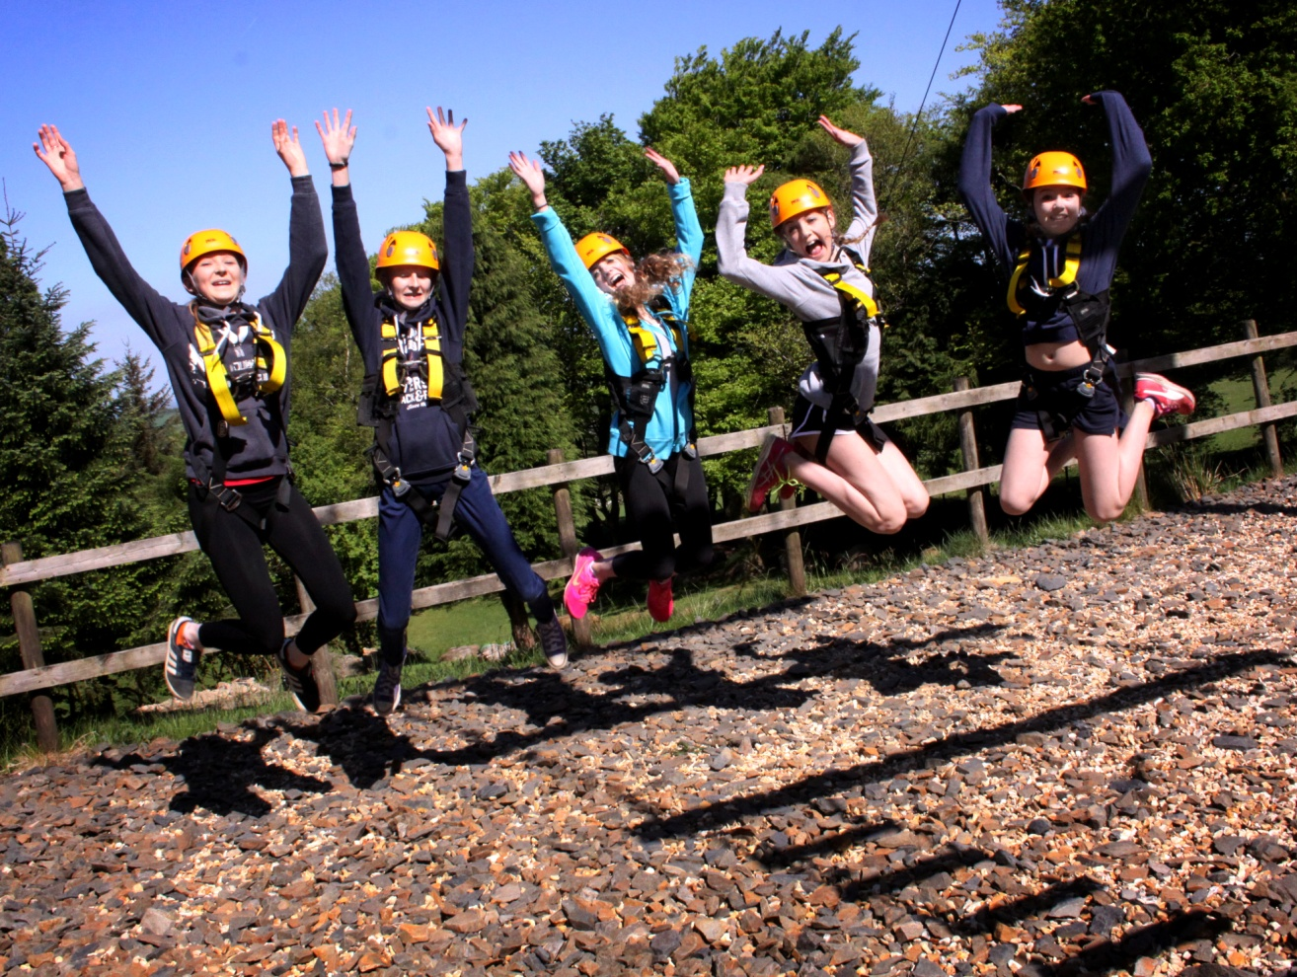


Okehampton Residential
Monday 15th September – Friday 19th September

Slide 2
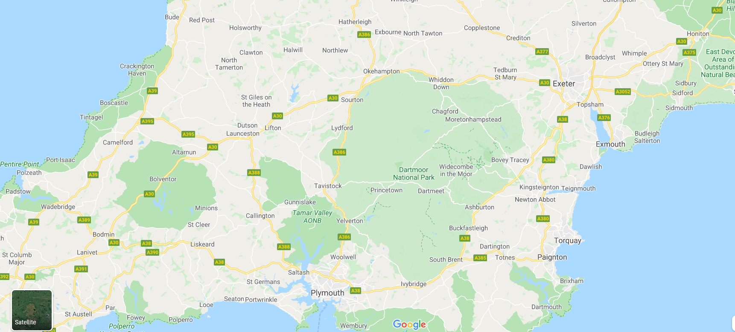
Location
Based just outside of Okehampton town, at the very top of Dartmoor National Park
Klondyke Road, Okehampton, EX20 1TP, 01837 53916

Slide 3
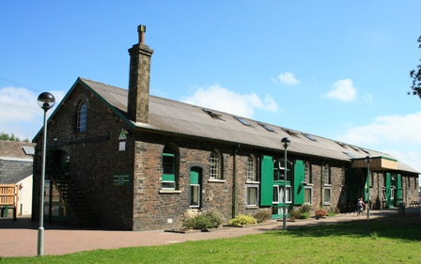
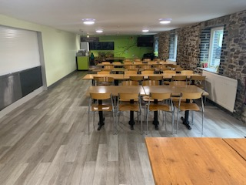
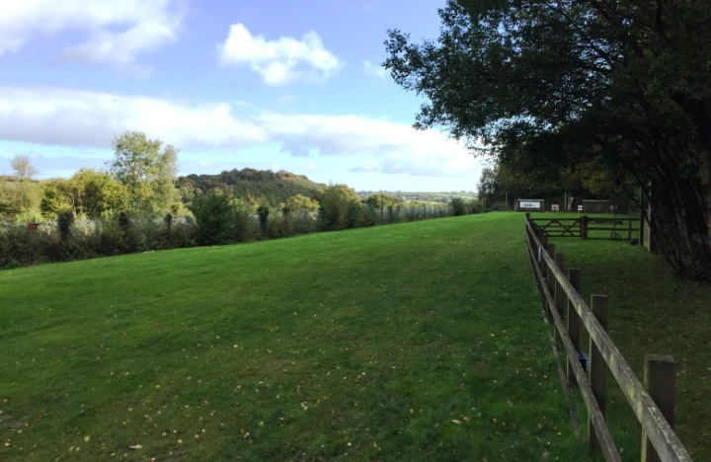
The Goods Shed
26 Bedrooms – 126 Beds
2,4 & 6 bed dorms
23 Bathrooms (11 en-suite)
The dining room
Seating for up to 70
The site
6 Acres
Playing field, Low Ropes Course, Archery Range,
Team Building Area, Campfire area

Slide 4
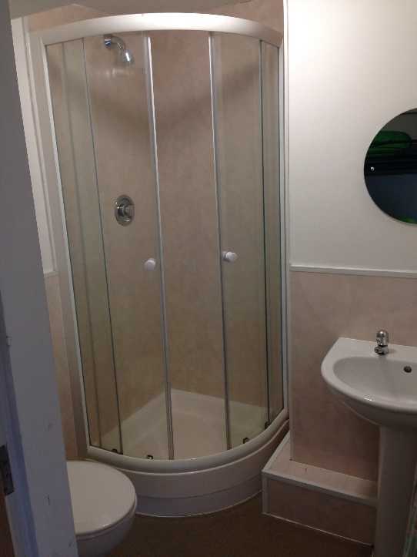
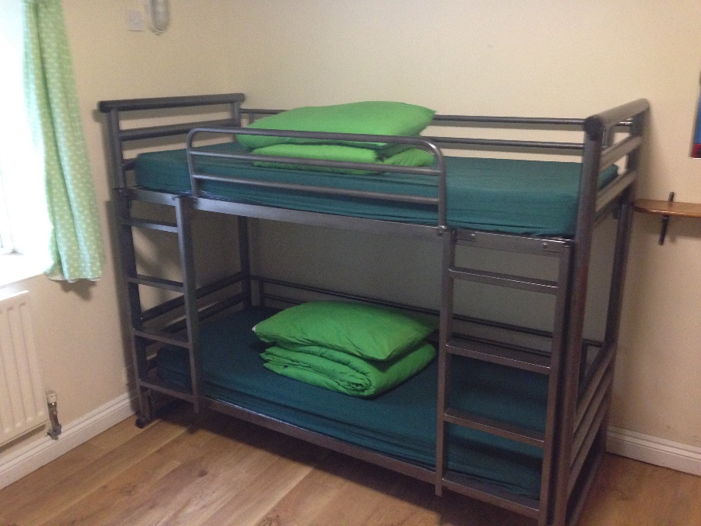
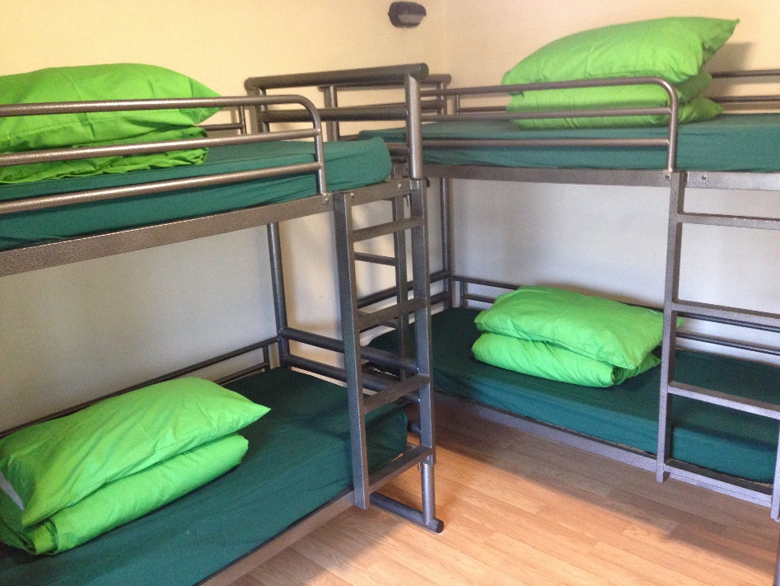
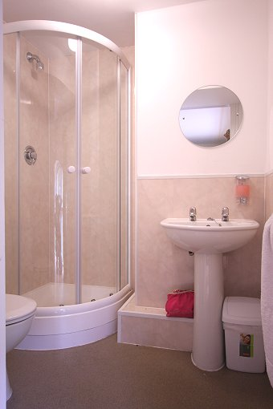
Bedrooms
Rooms of six or four beds
All bedding will be provided
(although you will have to make and unmake your bed!)

Slide 5
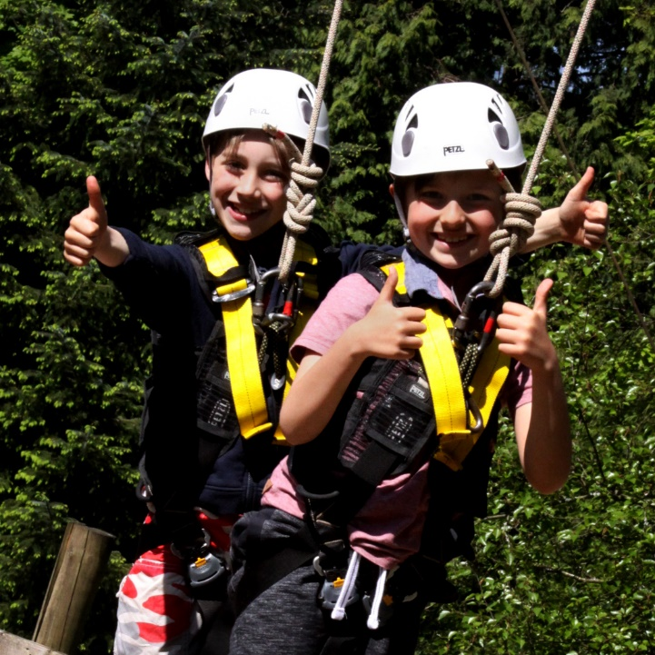
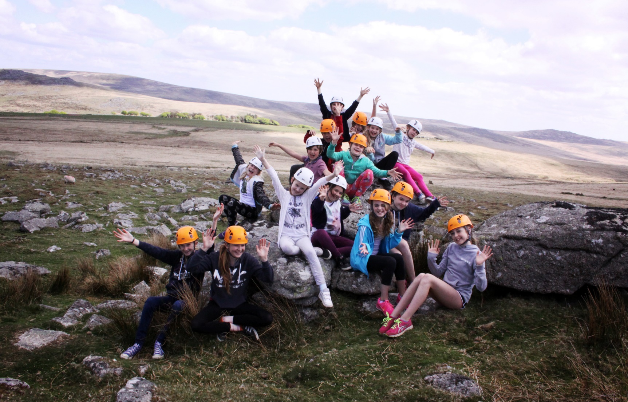
Activities

Slide 6
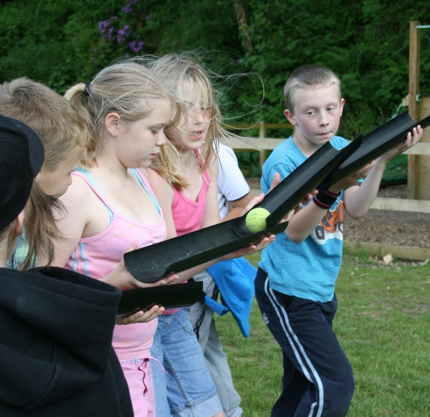
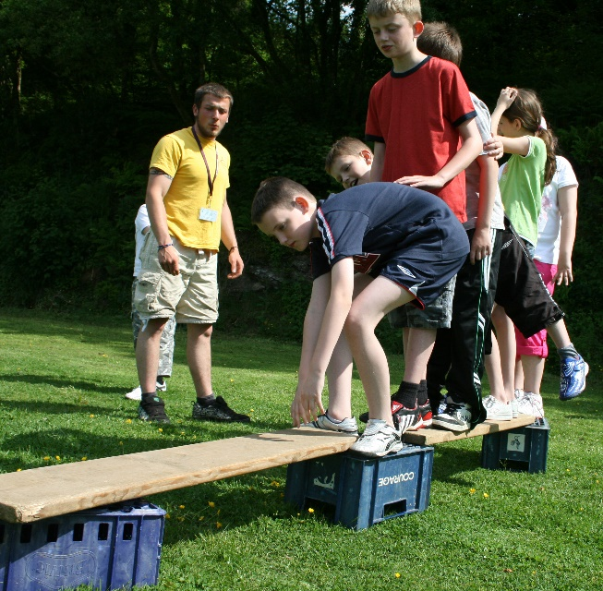
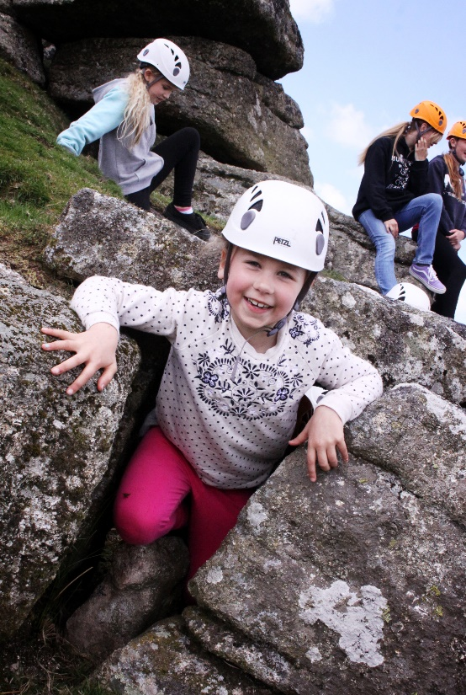
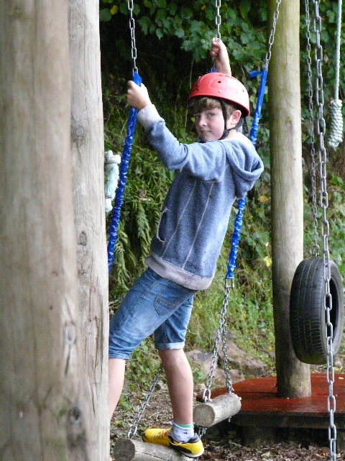
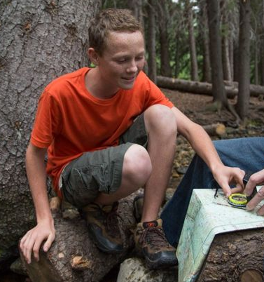
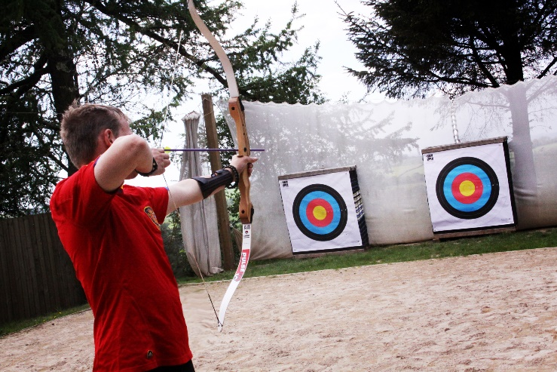
Team building
Archery
Weasling
Orienteering

Slide 7
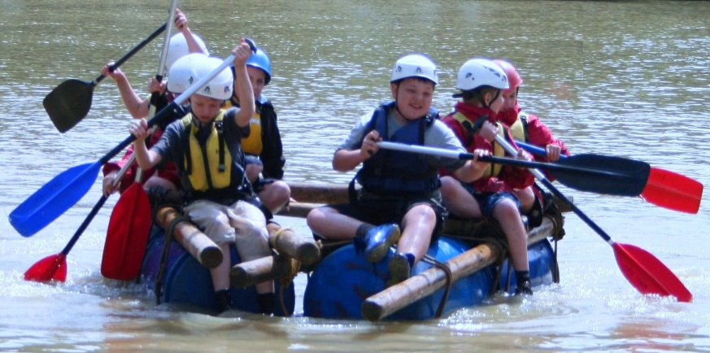
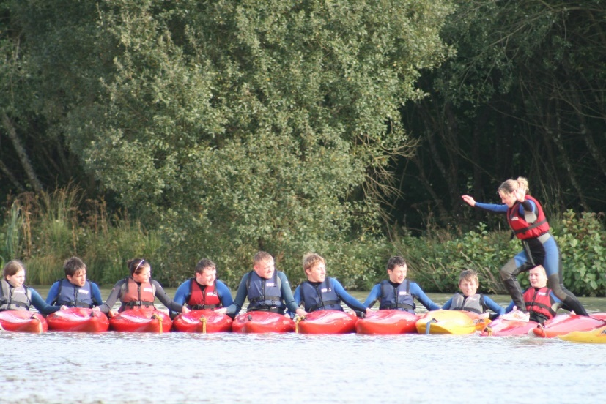
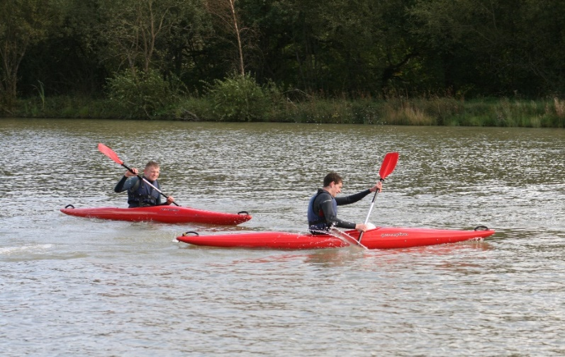
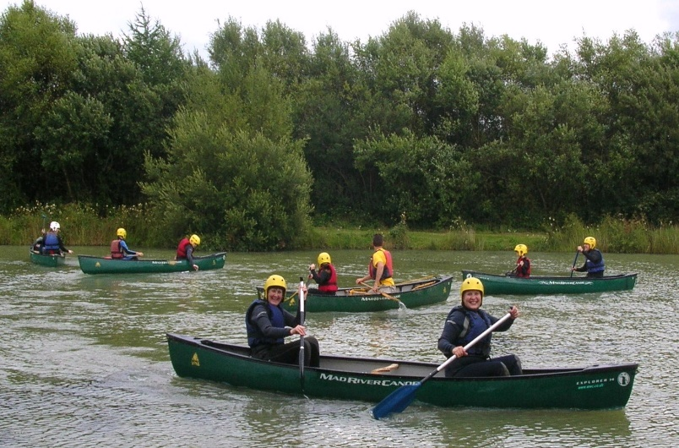
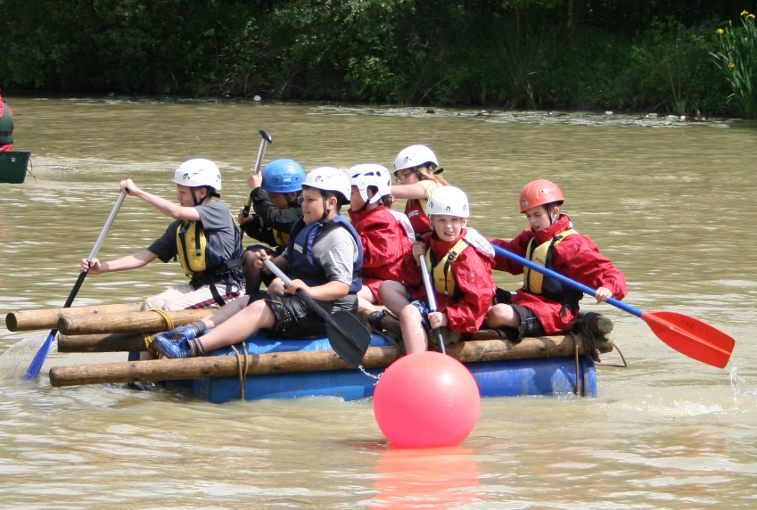
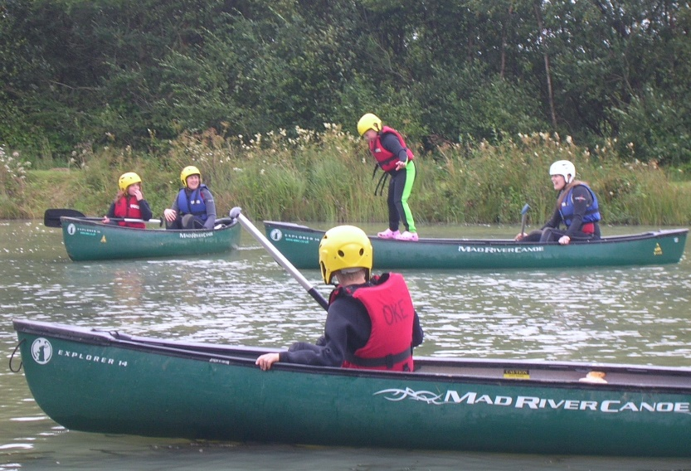
Canoeing kayaking
Raft Building

Slide 8
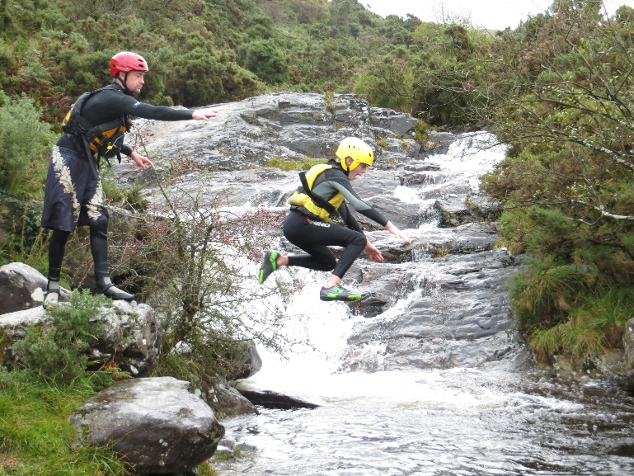
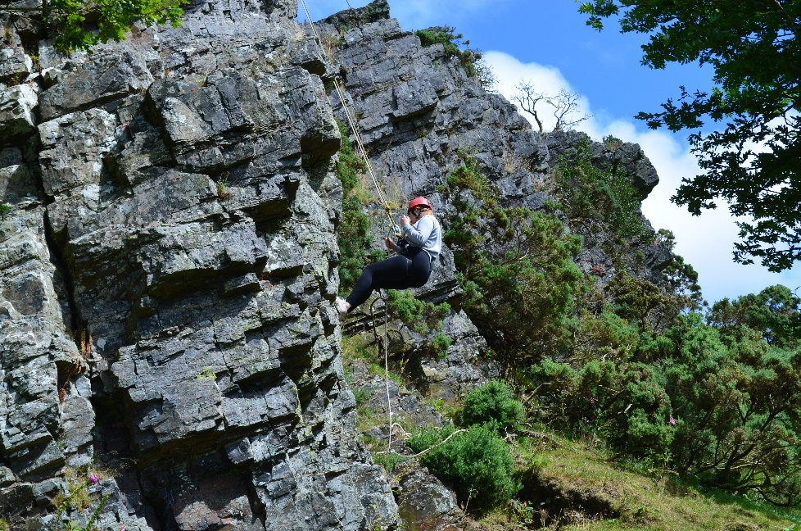
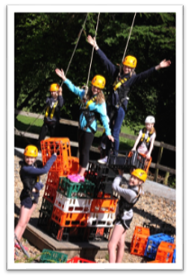
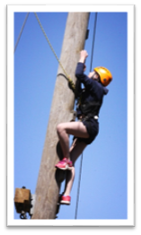
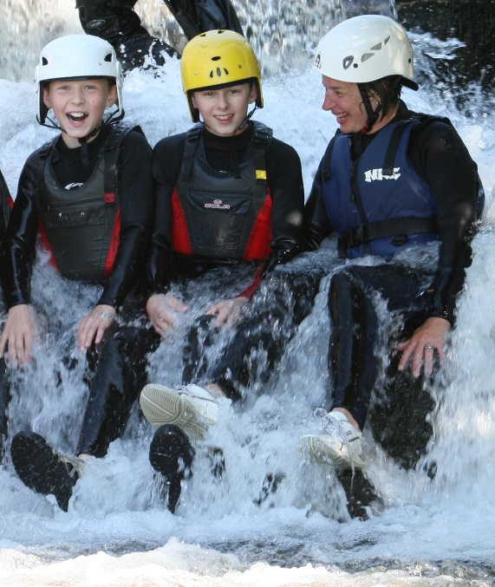
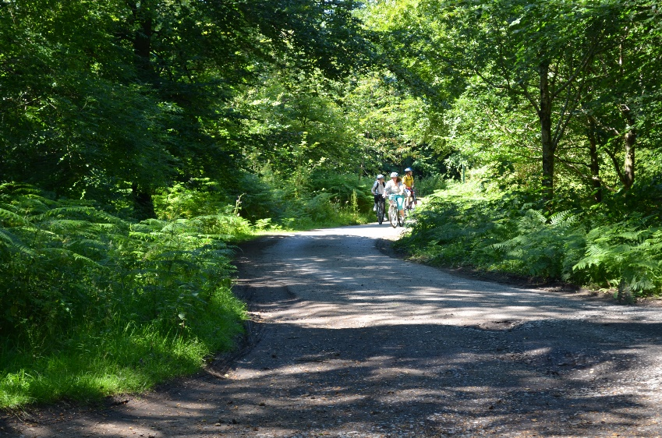
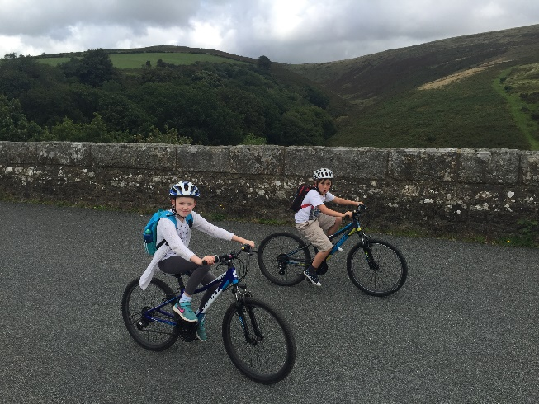
Cycling
Gorge
Scrambling
High Ropes

Slide 9


Breakfast Buffet
Available every day: toast, cereal, fruit and breakfast juice
Tuesday: Pork or Veggie Sausage, bacon, scrambled eggs, beans,
hash browns
Wednesday: Hot muffin filled with sausage patty, egg and cheese.
Blueberry muffins
Thursday: Pork or Veggie Sausage, bacon, scrambled eggs, beans,
hash browns
Friday: American pancakes with bacon or banana

Slide 10
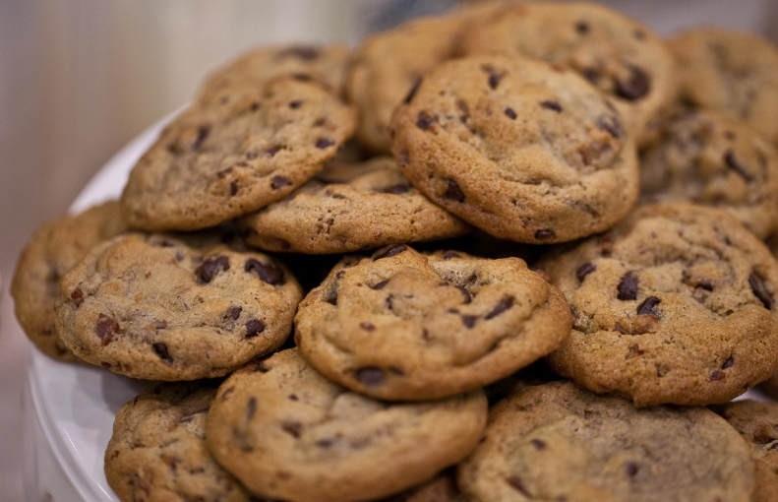


Lunch
Soft roll filled
with ham or cheese or tuna
Crisps, Fruit plus a home made snack
Bring your own water bottle to be filled from the
filling station every morning

Slide 11



Dinner
Monday – Pasta Bolognaise & Garlic Bread + Apple crumble & Custard
Tuesday – Roast Pork + Jelly and ice cream
Wednesday – Chicken pie + Chocolate brownie
Thursday – Pizza + Sticky toffee pudding & Custard
Vegetarian options available and
all dietary requirements can be catered for

Slide 12


Ordering food
Food will be ordered before going to Okehampton

Slide 13

Okehampton Kit List
Weather is unpredictable at the best of times, never more so than on Dartmoor, please ensure your child has appropriate clothing for all weather.
No money is needed and we do not allow mobile phones
This is a suggested kit list, please ensure your child has plenty of spare clothing due to the nature of activities and the weather, clothes can get wet so it is important to have dry clothes available.
General:
Plenty of spare clothing
Hat & Gloves (warm or cold)
Small rucksack/ Day bag
Torch
Towel x 2 (one for showers + one for sessions)
Wash items
Comfy shoes/ slippers (for inside the hostel)
Sun cream
Water bottle
Any Medication required
Water Activities:
Old trainers (that can get wet)
Swim Wear
Warm Jumper or Fleece
Full Change of clothes
We provide wetsuits (or you can bring your own)
Tracksuit bottoms or similar (No Jeans)
Land Activities:
Water proof jacket (& trousers although not essential)
Warm Jumper or Fleece
Trainers (Walking boots/Sturdy footwear)
Tracksuit bottoms or similar (No Jeans)

Slide 14
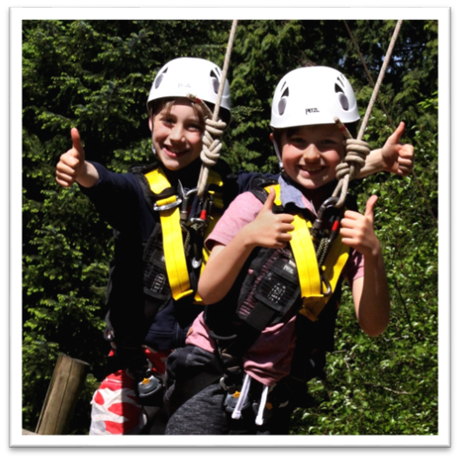
What you need to do…….
Have a look at the website so you familiarise yourselves with where we are going and the activities we will be doing
Complete forms sent home – medical, external visit form
Keep the kit list we have sent to you!!!
Begin to get excited!!!!!!!!!
Follow our school Facebook page

